Slide 1
Build a Native Android Application out of HTML, JavaScript and CSS
Russell Schwager
@rschwager

Slide 2
Place Holder for MM Info
Bullet points go here
And here
And here
etc...

Slide 3
What are “Chrome Apps”
Chrome Apps deliver an experience as capable as a native app, but as safe as a web page. Just like web apps, Chrome Apps are written in HTML5, JavaScript, and CSS. But Chrome Apps look and behave like native apps, and they have native-like capabilities that are much more powerful than those available to web apps.

Slide 4
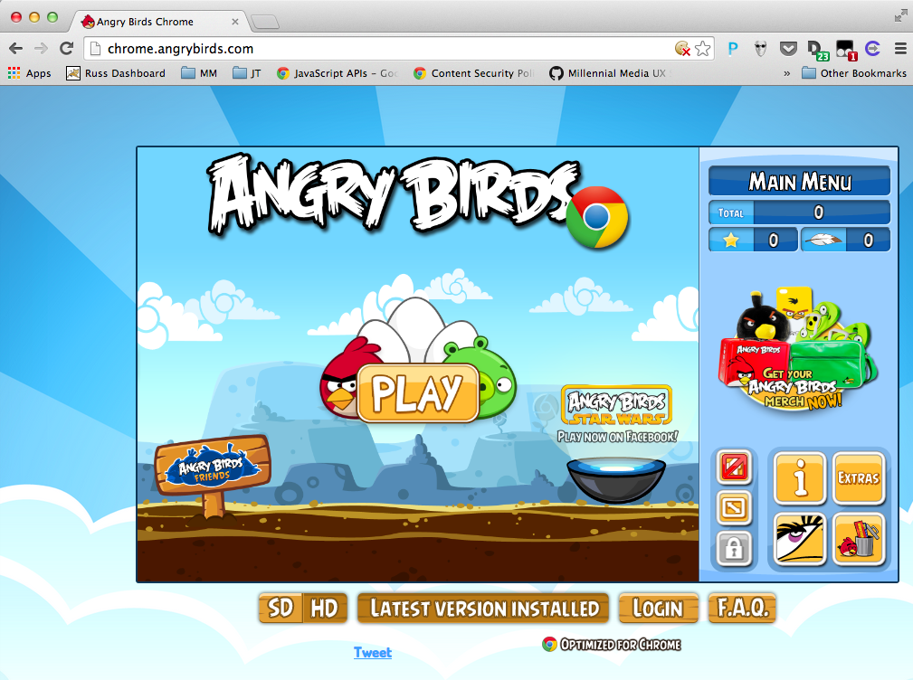
Example Chrome App

Slide 5
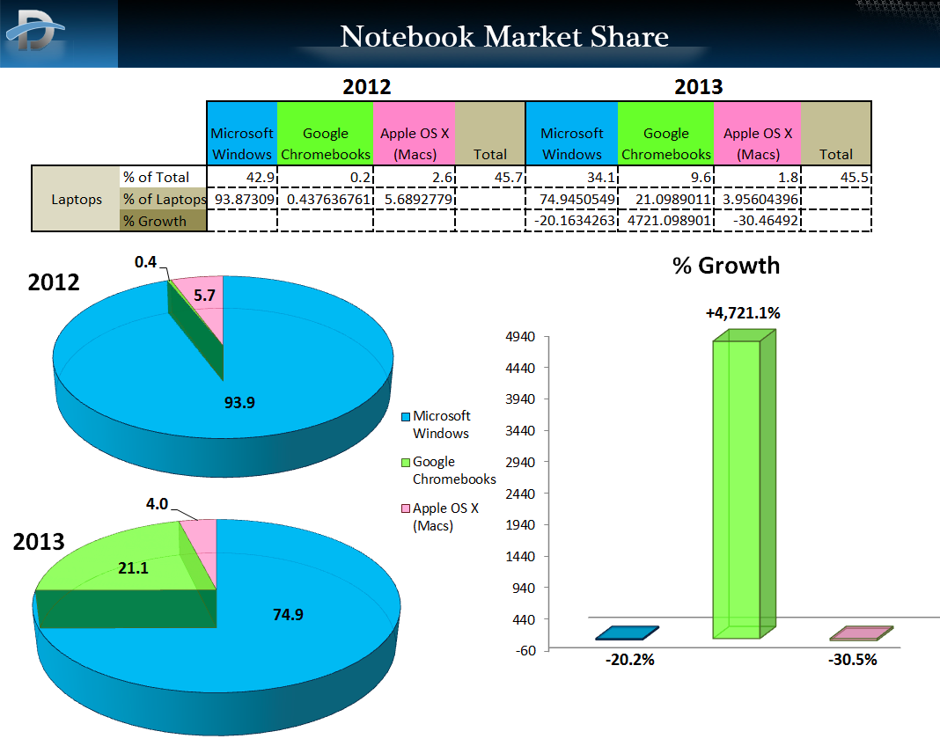
Source: http://www.dailytech.com/Chromebooks+Capture+21+Percent+of+2013+US+Notebook+Sales/article33985.htm

Slide 6
Chrome App Stack
Apache Cordova
HTML
Javascript
CSS
Chrome Security Model
Chome API and Services
App Container

Slide 7
App Security Model
https://developer.chrome.com/apps/contentSecurityPolicy
You can’t use inline scripting in your Chrome App pages. The restriction bans both <script> blocks and event handlers (<button onclick="...">).
You can’t reference any external resources in any of your app files (except for video and audio resources). You can’t embed external resources in an iframe.
You can fetch remote resources via XMLHttpRequest and serve them via blob:, data:, or filesystem: URLs
You can’t use string-to-JavaScript methods like eval() and new Function().

Slide 8
Chrome API and Services – Support on Mobile
https://developer.chrome.com/apps/api_index
alarms - Android and iOS
fileSystem - Android and iOS
i18n - Only some methods are supports
identity - Android and iOS
idle - Android and iOS
notifications - Android only
power - Android and iOS
pushMessaging - Beta quality on Android and iOS.
socket - Android and iOS.
storage - Android and iOS.
syncFileSystem - Beta quality on Android and iOS

Slide 9
Chrome Services and APIs - Not supported on Mobile
https://github.com/MobileChromeApps/mobile-chrome-apps/blob/master/docs/APIStatus.md
bluetooth
commands
contextMenus
mediaGalleries
permissions
serial
systemInfo.cpu
systemInfo.display
systemInfo.memory
systemInfo.storage
tts
types
usb
webstore
<webview> tag
NaCl

Slide 10
Building your own - Prerequisites
https://github.com/MobileChromeApps/mobile-chrome-apps/blob/master/docs/Installation.md
Node.js
For Android Development
Java 7 JDK
Android SDK
Apache Ant
The cca command line tool
npm install –g cca
cca checkenv

Slide 11
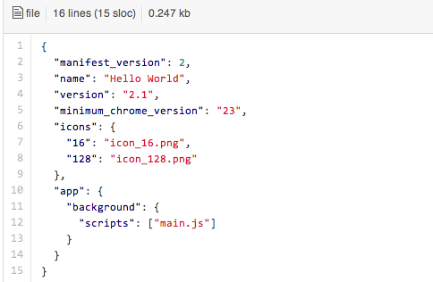
“Hello World!” – Manifest.json

Slide 12
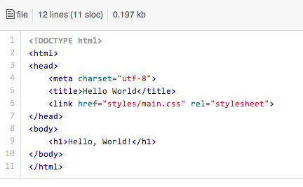
“Hello World!” – index.html

Slide 13
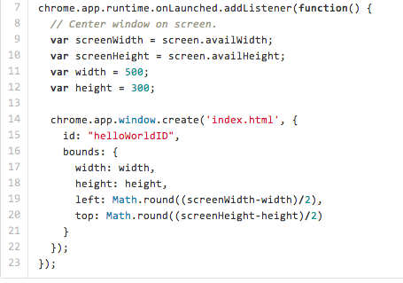
“Hello World!” – main.js

Slide 14
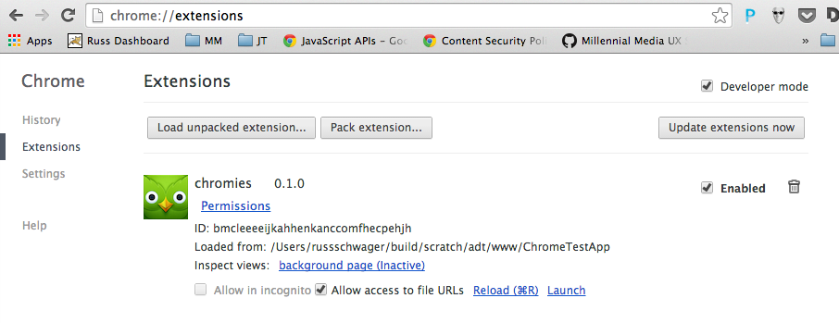
Testing and Debugging
Use Chrome Developer Tools!

Slide 15
Debugging on the Device/Emulator
https://github.com/MobileChromeApps/mobile-chrome-apps/blob/master/docs/Develop.md
Using the cca command line tool:
To run your app on the Android Emulator: cca emulate android
Note: This requires that you've set up an emulator. You can run android avd to set this up. Download additional emulator images by running android. To make the intel images run faster, install Intel's HAXM.
To run your app on a connected Android device: cca run android
Debugging on the device using developer tools
See https://developer.chrome.com/devtools/docs/remote-debugging

Slide 16
More information
Millennial Media: http://www.millennialmedia.com
My sample app: https://github.com/rschwager/andevcon-sample
Chrome Mobile Apps Documentation and Samples: https://github.com/MobileChromeApps/mobile-chrome-apps
Chrome Web Apps Samples: https://github.com/GoogleChrome/chrome-app-samples

Slide 17
Thank you

